Slide 1
Integrated Digital Cockpit Architecture
What should the hardware and software architecture of the integrated digital cockpit look like?

Slide 2
Problem statements
Consider a four screen layout as show. The passenger / rear seat could actually be multiple screens, for example two rear seat screens, but the for the design purposes assume the functionality of these to be the same regardless of whether there is more than one or of front or rear passenger.
IVI and Passenger screen will have touch input, the others will not. The cluster may have steering wheel controls though it is debatable whether that really is input to the cluster and not the IVI system.
The digital cockpit performs several “Functions”. I’m avoid the use of apps since that term can evoke pre-conceived ideas even though they may ultimately be implemented as apps. Examples include navigation, multimedia, phone call, etc.
These functions may potentially display content on all screens. Each function displays a different level of detail on each screen so taking navigation as an example:
HUD – just a turn indicator
IC – turn indicator with distance, name of turn
Center stack – map with turn directions
Passenger screen – map with destination entry
An advanced option is that that functions are swiped from one screen to another. For example a front passenger may start an app then send it to the center stack screen.
The Instrument Cluster displays not just driver centric information such as speed, tell tales, vehicle status, but also IVI functionality. The question is, how does the display content that is IVI functionality get rendered on the cluster display.
HUD
Instrument Cluster
IVI
(Center Stack)
IVI (Passenger
Screen and/or Rear Seat)
Screen Layout (assuming left hand drive)

Slide 3
System Architecture
IVI
Input: Touch screen, CANbus data, control knob.
Code executed on IVI can display on all 4 screens.
HUD
Display only. Display content comes from the ASIL-D RTOS domain and the IVI domain.
Instrument Cluster
Large similarities to the HUD
Display only. Display content comes from the ASIL-D RTOS domain and the IVI domain.
Passenger Screen
Functions run on the Linux domain.
Input: Touch screen
Discussion Points
Where do the steering wheel control input go?
Should the cluster OS just be responsible for rendering driver status information and all IVI functionality be controlled from the IVI domain? If the answer is yes then the steering wheel controls go to the IVI domain. This means the cluster just displays the instrument dials, other critical driving information and the telltales. All other information comes from the IVI domain – see following slides.
HUD
IVI
(Center Stack)
IVI (Passenger
and/or RSE)
Screens
Instrument Cluster
HUD
Cluster
IVI
App Layer
ASIL-D RTOS
e.g. QNX, INTEGRITY
Linux
OS Domains
SoC with Hypervisor
CANbus

Slide 4
Mapping Application Code to Screens
How does the display content from functions executing in the IVI environment get displayed on the Cluster and HUD screens? There are two options; one is to have two graphics planes that cover all the display surfaces, one for each OS domain. This could be memory costly. The other is to use something like EGLstreams that only NVIDIA supports.
HUD
Cluster
IVI + Functions
Application Code
Cluster & HUD
Two separate graphics planes covering all screens. Cluster is above IVI. Each domain writes to it’s respective plane.
Easy to share display content between OS domains.
Display buffers are sparsely populated with content so inefficient in terms of memory use.
Easy to have windows “slide” between screens
IVI
Nav HUD
Nav Cluster
Nav IVI
App writes to separate windows for each screen’s content.
Cluster & HUD
IVI
Windows are streamed to the HUD/Cluster domain OS
Less graphics memory required
Less GPU as writing to fewer pixels?

Slide 5
Mapping Application Code to Screens
How does the display content from functions executing in the IVI environment get displayed on the Cluster and HUD screens? There are two options; one is to have two graphics planes that cover all the display surfaces, one for each OS domain. This could be memory costly. The other is to use something like EGLstreams that only NVIDIA supports.
HUD
Cluster
IVI + Functions
Application Code
Cluster & HUD
Two separate graphics planes covering all screens. Cluster is above IVI. Each domain writes to it’s respective plane.
Easy to share display content between OS domains.
Display buffers are sparsely populated with content so inefficient in terms of memory use.
Easy to have windows “slide” between screens
IVI content for cluster
IVI content for center stack
Cluster & HUD
IVI
App writes to separate windows for each screen’s content.
Nav
Nav
Nav
Windows are streamed to the HUD/Cluster domain OS
Less graphics memory required
Less GPU as writing to fewer pixels?

Slide 6
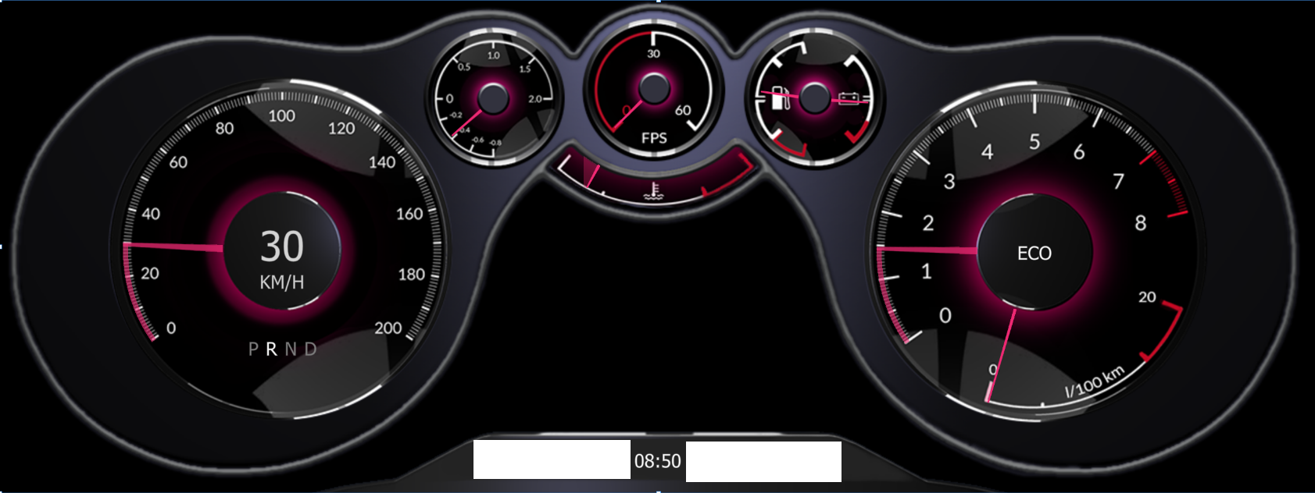

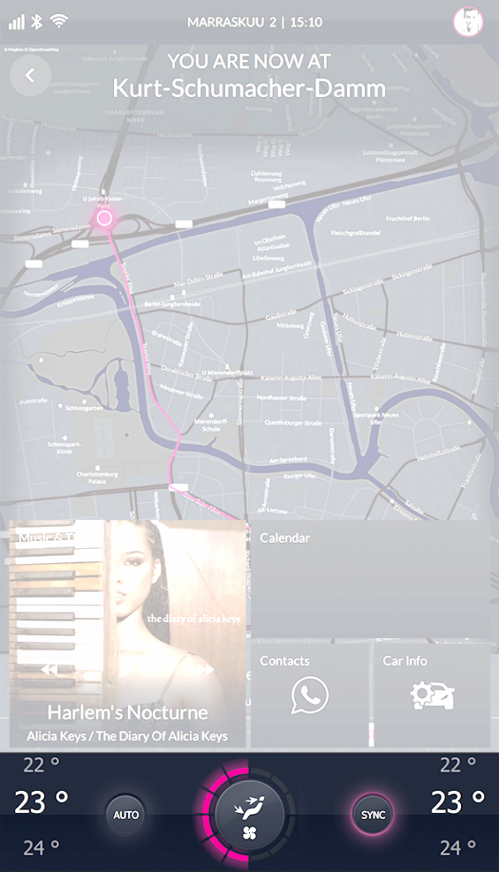
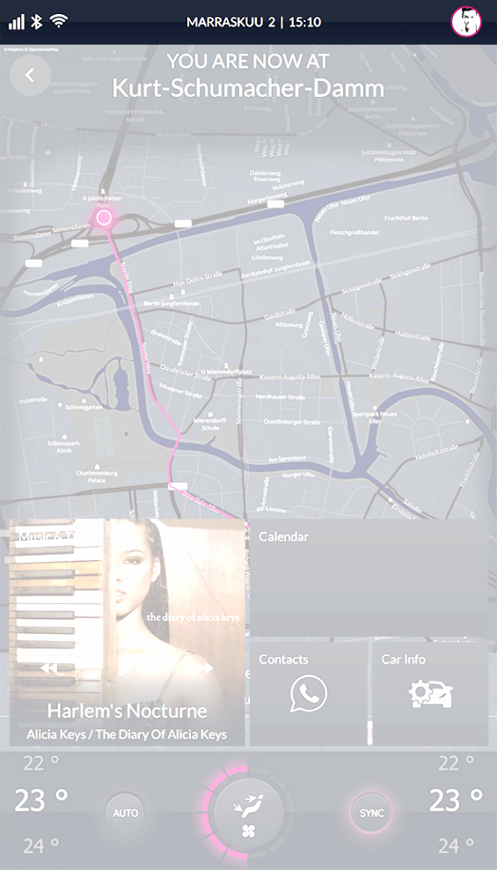
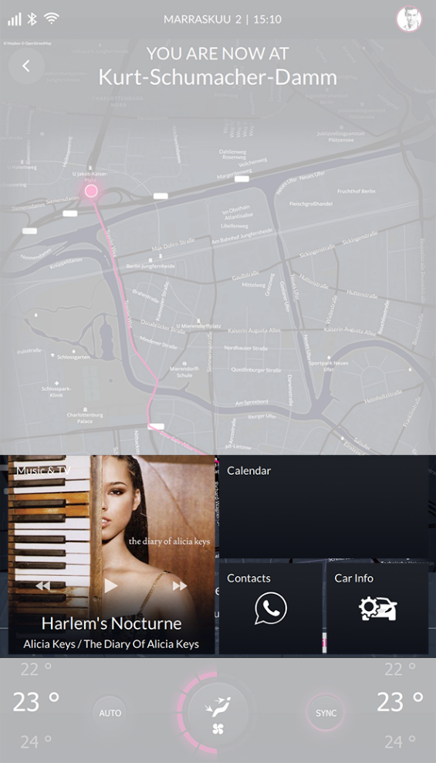
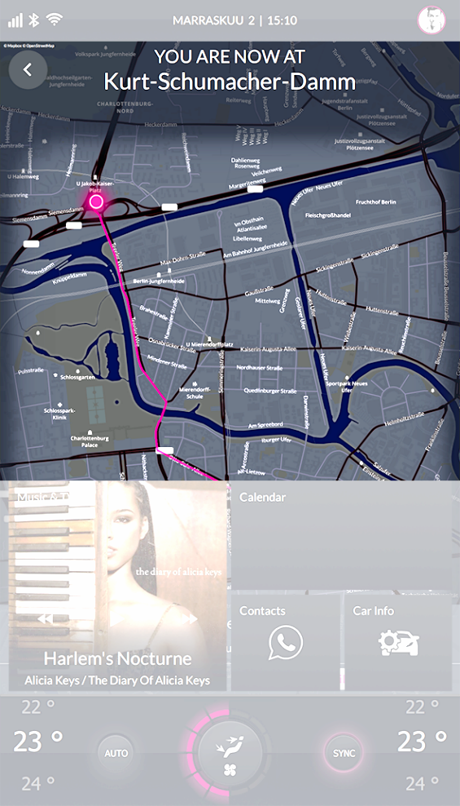
Qt World Summit implementation
IVI Content graphics plane
Safety critical graphics plane
IVI + Cluster UI
ASIL-B
Tell-tales
Qt
Qt Safe Renderer
OS / Linux
ASIL-D RTOS
Type 1 Hypervisor (SC)
SoC

Slide 7
Cluster Screen: bringing all the content together
IVI Content graphics plane
Safety critical graphics plane
Non safety critical graphics plane
IVI UI
Cluster UI
ASIL-B
There is a 3rd video layer needed by the cluster screen and that is for functional safety. The Qt Safe Renderer draws the safety critical part that includes the telltales and is largely transparent as illustrated by the dark blue outlined layer. The non-safety critical dials and other driver specific information is also drawn by the ASIL domain as illustrated by the green outlined layer.
Portions of the non-safety layer are transparent to allow the IVI functionality to be displayed in the case where there is a 3rd plane underneath for the IVI layer that spans all displays.
A complication is that there could be different cluster modes where the size of the dials change and with it the area available to the IVI content. This implies a communication channel between the IVI and cluster domains to signal these configuration changes.
There should be a fallback cluster configuration in the event the IVI domain fails.
Tell-tales
Qt
Qt
Qt Safe Renderer
OS / Linux
ASIL-D RTOS
Type 1 Hypervisor (SC)
SoC

Slide 8
Functional Safety using separate graphic plane
Safety Critical
Cluster & HUD
Hardware compositor
LCD Panel
IVI
QtSafeRenderer
ASIL-D RTOS
e.g. QNX, INTEGRITY
QtSafeRenderer controls how the various graphics plans are composited. If error is detected then on the safety critical plane is displayed.
This slide illustrates the three planes working together with functional safety in the case where functional safety is implemented by the Qt 3D Renderer and the IVI content comes from shared planes rather than buffer streaming across OS domains.
This slide illustrates the three planes working together with functional safety in the case where functional safety is implemented by the Qt 3D Renderer and the IVI content comes from shared planes rather than buffer streaming across OS domains.

Slide 9
Functional Safety using On-Screen-Display (OSD)
This slide illustrates an alternative functional safety design which uses the On Screen Display capability in many monitors to implement the rendering of telltales.
This slide illustrates an alternative functional safety design which uses the On Screen Display capability in many monitors to implement the rendering of telltales.
CANbus data to drive safety critical features
OSD
Telltale generation etc.
Cluster & HUD
Hardware compositor
LCD Panel
IVI

